Slide 1
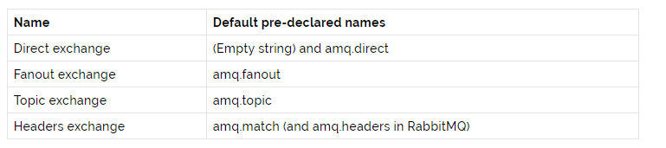
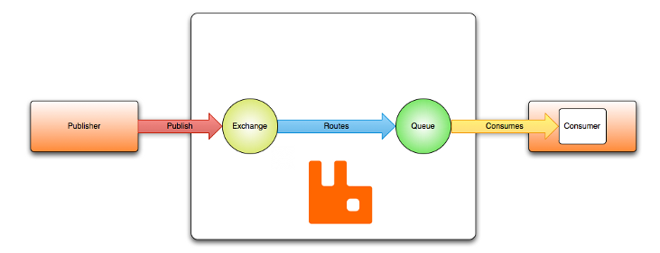
AMQP 0-9-1 Model - Exchanges and Exchange Types
Exchanges are AMQP entities where messages are sent. Exchanges take a message and route it into zero or more queues. The routing algorithm used depends on the exchange type and rules called bindings.
Exchanges can be durable or transient. Durable exchanges survive broker restart whereas transient exchanges do not (they have to be redeclared when broker comes back online). Not all scenarios and use cases require exchanges to be durable.

